Slide 1
Introduction to
Computer Administration

Slide 2
Computer Network -
Basic Concepts
Computer Networks
Communication Model
Transmission Modes
Communication Types
Classification Of Computer Networks
  By Scale
  By Structure
  By Topology
Network Media
Internetworking

Slide 3
Computer Network
A computer network is a group of interconnected computers.
It allows computers to communicate with each other and to share resources and information.
First Network : The Advanced Research Projects Agency (ARPA) funded the design of the "Advanced Research Projects Agency Network" (ARPANET) for the United States Department of Defense

Slide 4
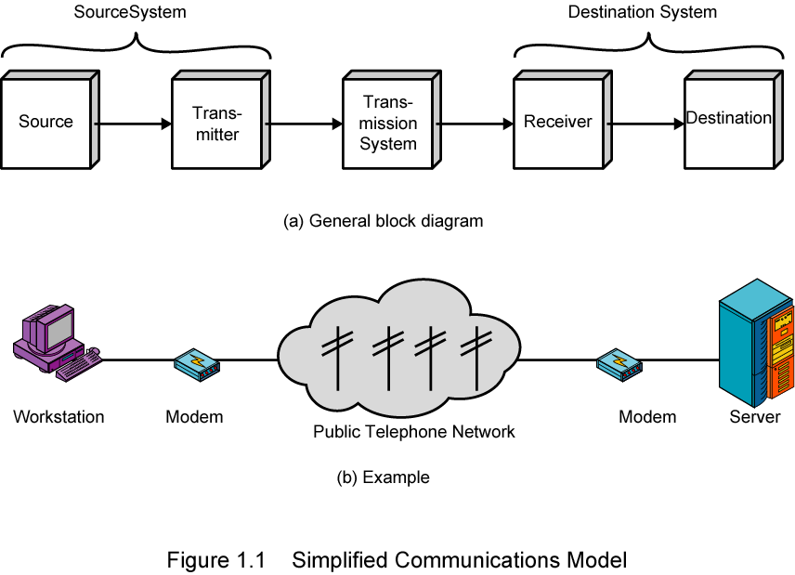
Communication Model

Slide 5
Communication Model
Source
  generates data to be transmitted
Transmitter
  Converts data into transmittable signals
Transmission System
  Carries data
Receiver
  Converts received signal into data
Destination
  Takes incoming data

Slide 6
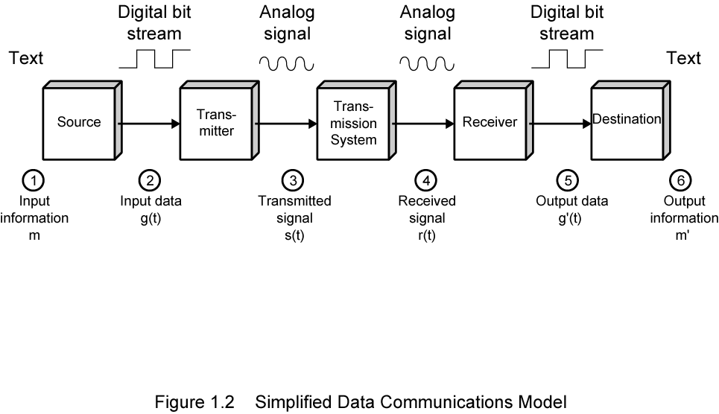
Communication Model

Slide 7
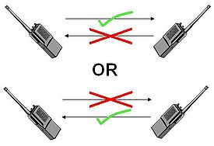

Transmission Modes
Simplex
  One direction
    e.g. Television
Half duplex
  Either direction, but only one way at a time
    e.g. police radio
Full duplex
  Both directions at the same time
    e.g. telephone

Slide 8
Communication Types
Unicasting (one-to-one)
Multicasting (one-to-many)
Broadcasting (one-to-all)

Slide 9
Network Classification
By Size or Scale
  LAN
  WAN
  MAN
  CAN
  PAN

Slide 10
Local Area Network (LAN)
Contains printers, servers and computers
Systems are close to each other
Contained in one office or building
Organizations often have several LANS
Notes:
Teaching tip
Use a real world example to describe an organization with interconnected LANs.

Slide 11
Wide Area Networks (WAN)
Two or more LANs connected
Over a large geographic area
Typically use public or leased lines
  Phone lines
  Satellite
The Internet is a WAN
Notes:
Teaching tip
Use a real world example to describe an organization with interconnected LANs.

Slide 12
Metropolitan Area Network (MAN)
Large network that connects different organizations
Shares regional resources
A network provider sells time

Slide 13
Campus Area Networks (CAN)
A LAN in one large geographic area
Resources related to the same organization
Each department shares the LAN

Slide 14
Personal Area Network (PAN)
Very small scale network
Range is less than 2 meters
Cell phones, PDAs, MP3 players

Slide 15
Network Classification
By Structure / Functional Relationship
  Client / Server
  Peer to Peer (P2PN)

Slide 16
Client/Server network
Nodes and servers share data roles
Nodes are called clients
Servers are used to control access
Database software
  Access to data controlled by server
Server is the most important computer

Slide 17
Peer to peer networks (P2PN)
All nodes are equal
Nodes access resources on other nodes
Each node controls its own resources
Most modern OS allow P2PN
Distributed computing is a form
Kazaa

Slide 18
Network Classification
By Topology / Physical Connectivity
  BUS
  STAR
  RING
  MESH
  TREE

Slide 19
Point-to-point topology
Point-to-point topology is the simplest of all the network topologies. The network consists of a direct link between two computers. This is faster and more reliable than other types of connections since there is a direct connection. The disadvantage is that it can only be used for small areas where computers are in close proximity.

Slide 20
Network Topology
  Logical layout of wires and equipment
  Choice affects
    Network performance
    Network size
    Network collision detection

Slide 21
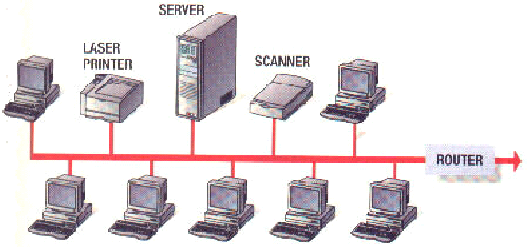
BUS
Also called linear bus
One wire connects all nodes
Terminator ends the wires
Advantages
  Easy to setup
  Small amount of wire
Disadvantages
  Slow
  Easy to crash

Slide 22
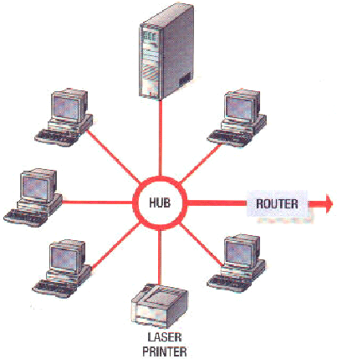
STAR
All nodes connect to a hub
  Packets sent to hub
  Hub sends packet to destination
Advantages
  Easy to setup
  One cable can not crash network
Disadvantages
  One hub crashing downs entire network
  Uses lots of cable
Most common topology

Slide 23
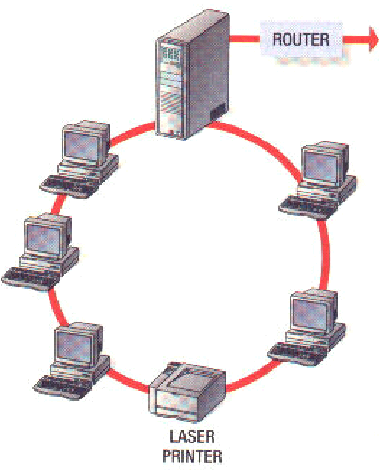
RING
Nodes connected in a circle
Tokens used to transmit data
  Nodes must wait for token to send
Advantages
  Time to send data is known
  No data collisions
Disadvantages
  Slow
  Lots of cable

Slide 24
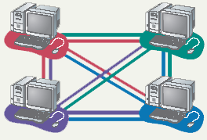
MESH
All computers connected together
Internet is a mesh network
Advantage
  Data will always be delivered
Disadvantages
  Lots of cable
  Hard to setup

Slide 25
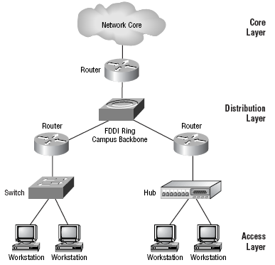
TREE
Hierarchal Model
Advantages
  Scaleable
  Easy Implementation
  Easy Troubleshooting

Slide 26
Network Media
Links that connect nodes
Choice impacts
  Speed
  Security
  Size

Slide 27
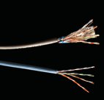
Twisted-pair cabling
Most common LAN cable
Called Cat5 or 100BaseT
Four pairs of copper cable twisted
May be shielded from interference
Speeds range from
1 Mbps to 1,000 Mbps

Slide 28
Coaxial cable
Similar to cable TV wire
One wire runs through cable
Shielded from interference
Speeds up to 10 Mbps
Nearly obsolete

Slide 29
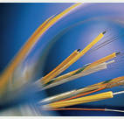
Fiber-optic cable
Data is transmitted with light pulses
Glass strand instead of cable
Immune to interference
Very secure
Hard to work with
Speeds up to
100 Gbps

Slide 30
Wireless Media
Data transmitted through the air
LANs use radio waves
WANs use microwave signals
Easy to setup
Difficult to secure

Slide 31
Internetwork
An Internetwork is the connection of two or more distinct computer networks or network segments via a common routing technology.
Any interconnection among or between public, private, commercial, industrial, or governmental networks may also be defined as an internetwork.

Slide 32
Internetwork
Intranet
  An intranet is a set of networks, using the Internet Protocol and IP-based tools such as web browsers and file transfer applications, that is under the control of a single administrative entity.
  Most commonly, an intranet is the internal network of an organization
Extranet
  An extranet is a network or internetwork that is limited in scope to a single organization or entity but which also has limited connections to the networks of one or more other usually, but not necessarily, trusted organizations or entities
  by definition, an extranet cannot consist of a single LAN; it must have at least one connection with an external network.
Internet
  The Internet consists of a worldwide interconnection of governmental, academic, public, and private networks based upon the networking technologies of the Internet Protocol Suite.
  It is the successor of the Advanced Research Projects Agency Network (ARPANET) developed by DARPA of the U.S. Department of Defense.
  The Internet is also the communications backbone underlying the World Wide Web (WWW).

